Slide 1


DIABETES PREDICTION
USING
SUPERVISED MACHINE LEARNING
A Systematic Approach to Predicting Diabetes with Machine Learning

Slide 2

OBJECTIVE
Construct a supervised machine learning model for diabetes prediction.
Train the system on a dataset with known diabetes status and medical parameters.
Predict diabetes status for new patients based on their medical characteristics.

Slide 3
FUNCTIONAL REQUIREMENTS
01
02
03
04
Predict diabetes status with at least 90% accuracy.
Manage a dataset of at least 10,000 patients.
Generate real-time forecasts.
Provide a full explanation of the prediction process to users.

Slide 4
NON-FUNCTIONAL REQUIREMENTS
01
02
03
04
05
Security: Ensure patient data security against unauthorized access.
Reliability: System availability of 99.9%.
Performance: Generate predictions within 1 second.
Scalability: System should handle an increasing number of users.
Usability: User-friendly interface for healthcare professionals and patients.

Slide 5
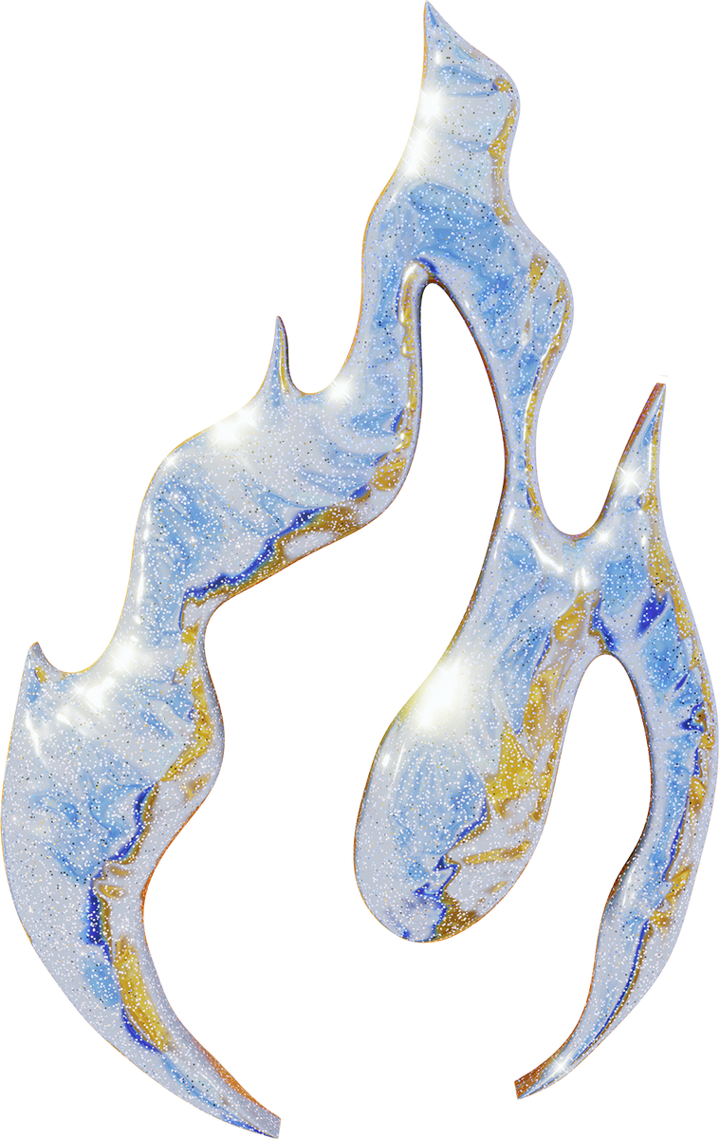
USE CASES
Users:
Utilization:
Healthcare professionals
Patients
Healthcare professionals can forecast patients' diabetes status for informed decision-making.
Patients can learn about their risk of diabetes and take preventive measures.

Slide 6
ASSUMPTIONS
Training data is indicative of the system's user population.
Medical characteristics used for training are significant for diabetes prediction.
The system has access to a reliable internet connection.
CONSTRAINTS
The system must run on a standard PC or mobile device.
Predictions must be provided within an acceptable timeframe.

Slide 7
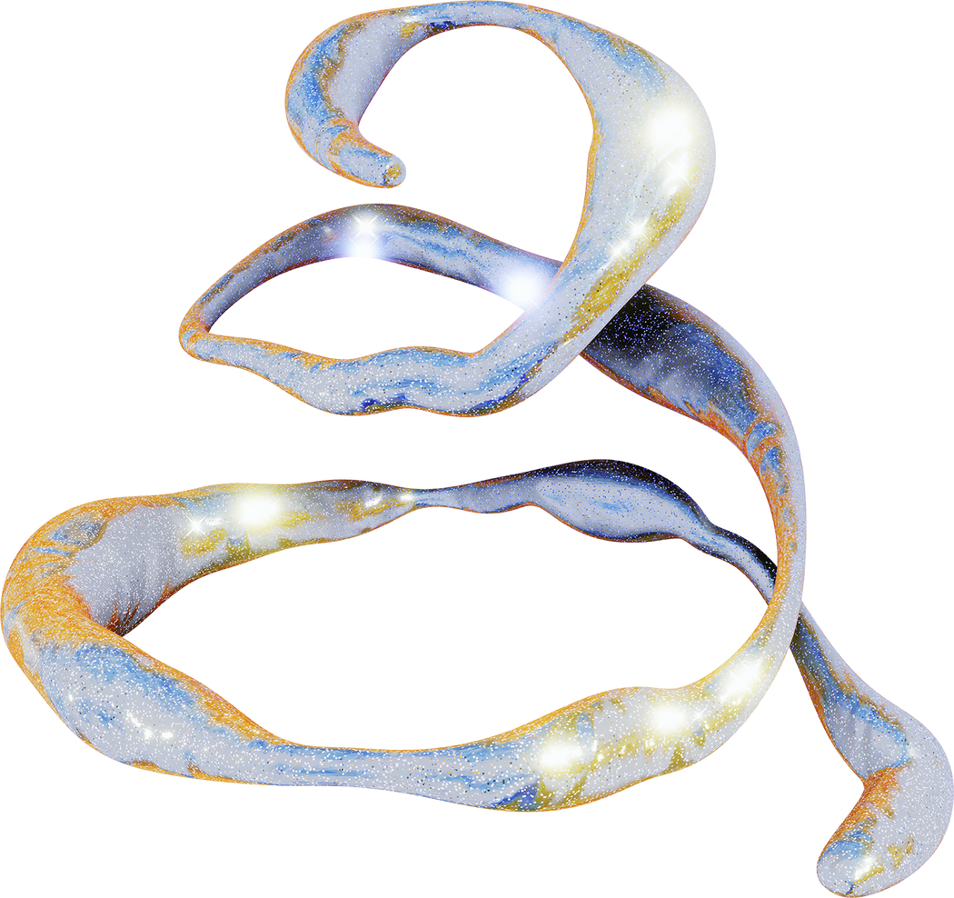
DESIGN
Modular architecture:
Data preparation component
Feature engineering component
Model training component
Prediction component
Explanation component

Slide 8
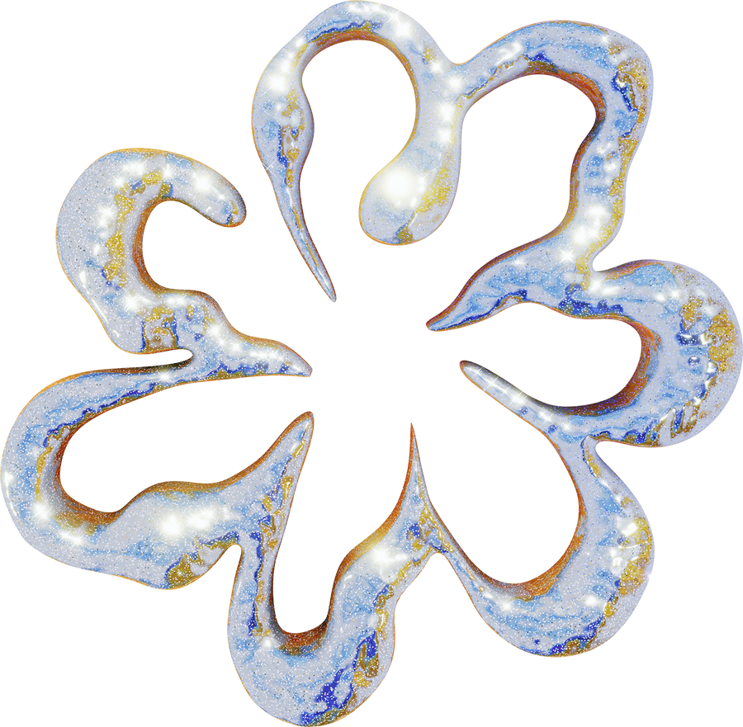
IMPLEMENTATION
Development using Python.
Utilizing machine learning libraries:
1. sci-kit-learn
2. pandas
3. NumPy
4. Matplotlib.pyplot
5. Seaborn

Slide 9
TESTING
TESTING METHODS
Unit testing
Integration testing
System testing
User acceptability testing

Slide 10
DEPLOYMENT
Deploying on a cloud-based platform for scalability and reliability.

Slide 11
MAINTENANCE AND SUPPORT
Maintenance and support are provided by a team of professional software developers.

Slide 12

FUTURE WORK
Areas for Future Work:
1. Improve model accuracy with more data and complex methods.
2. Add additional features to enhance prediction accuracy.

Slide 13
very much
THANK YOU
By,
Al Nafis Fuad Shuvo
Ayman Bin Alam
Ferdous Mahmud Fahad
Md Roman Talukdar
Prince Sarker Deganta
20051717
20051719
20051727
20051734
20051745

